Slide 1
DS Life Cycle
Arunkumar Nair
arunkg99@gmail.com
+91-9890652675

Slide 2
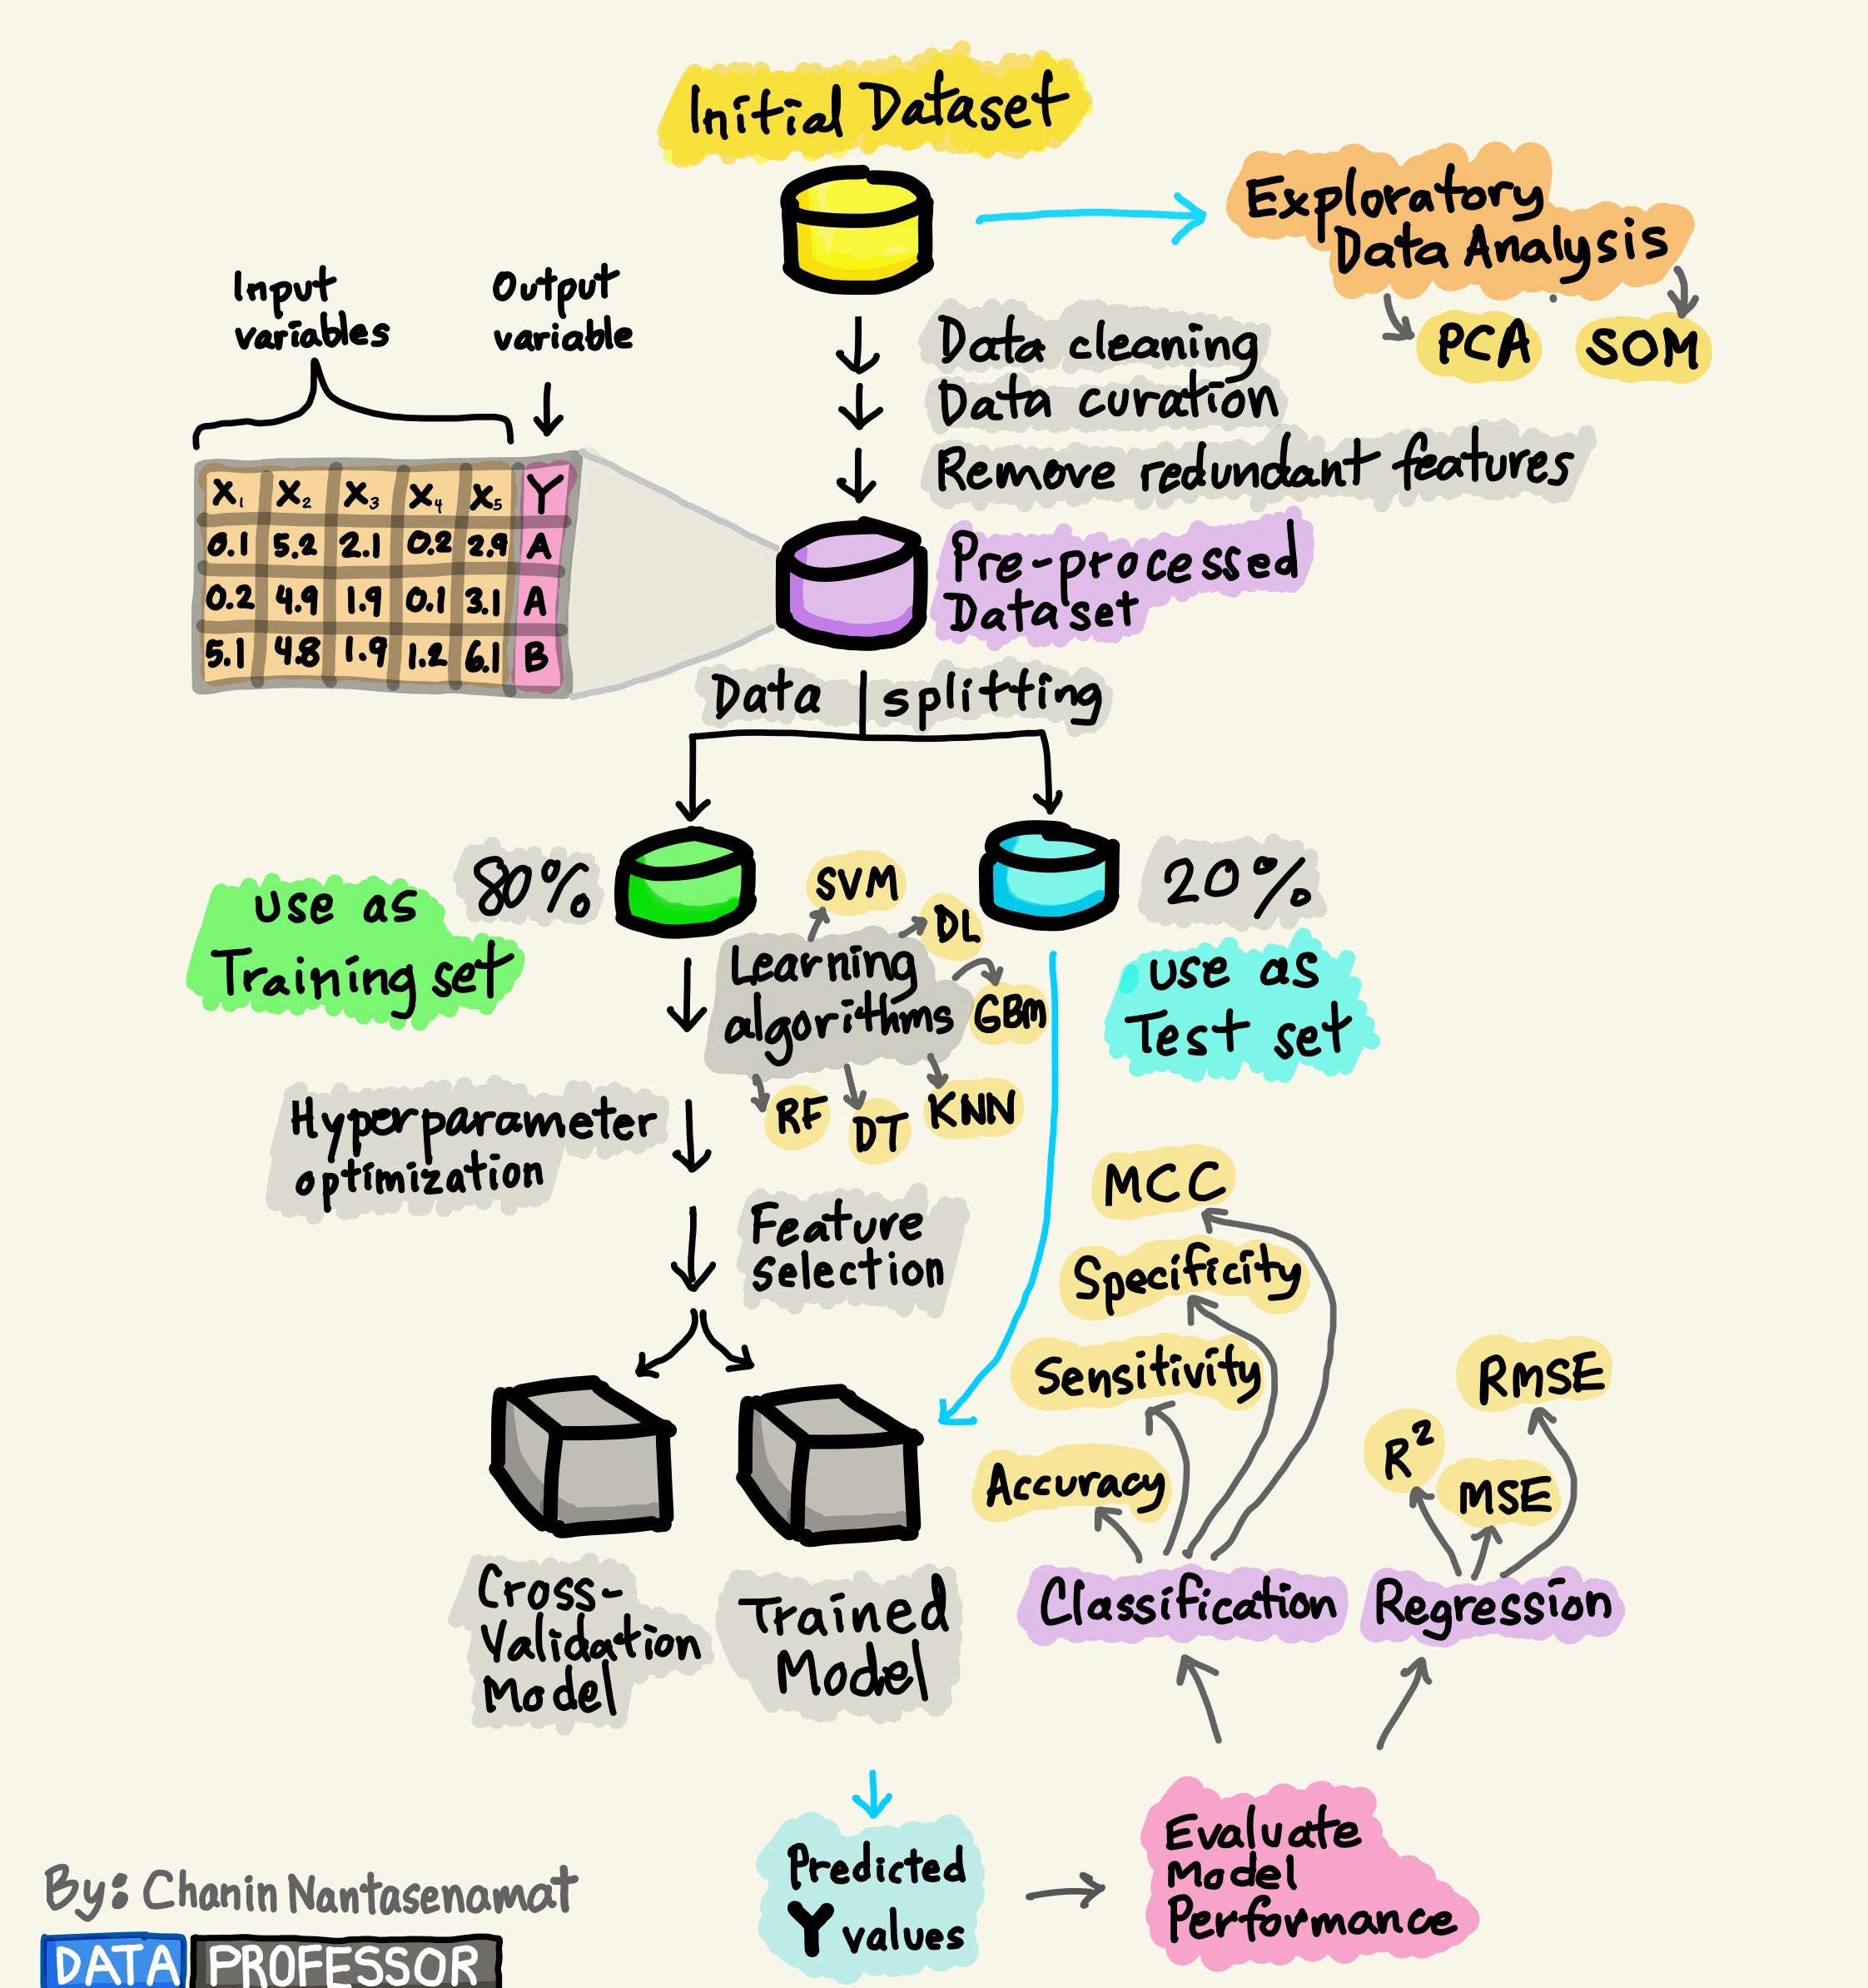
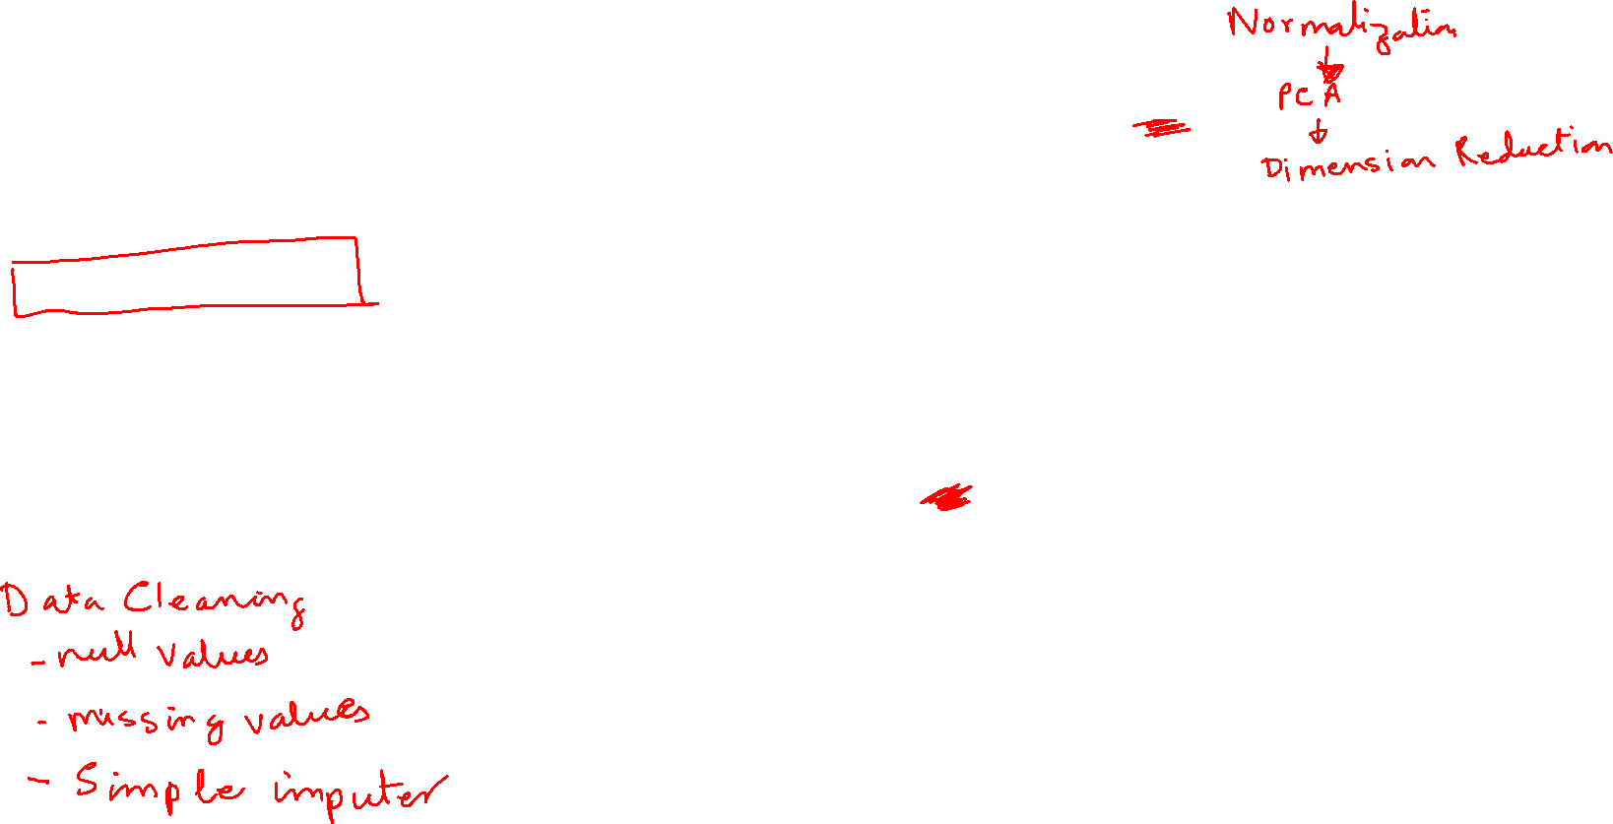
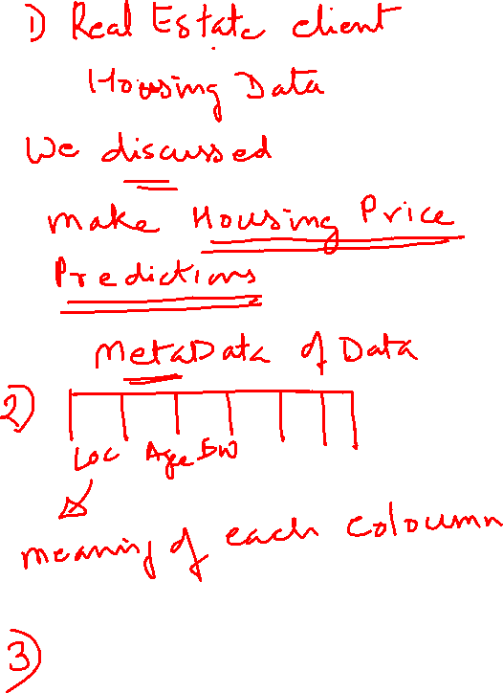

Slide 3
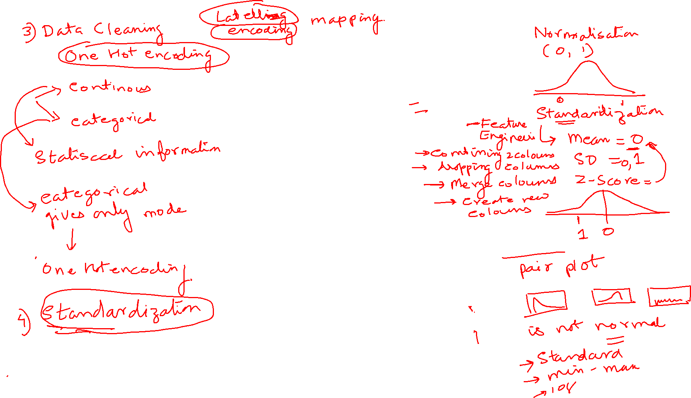

Slide 4
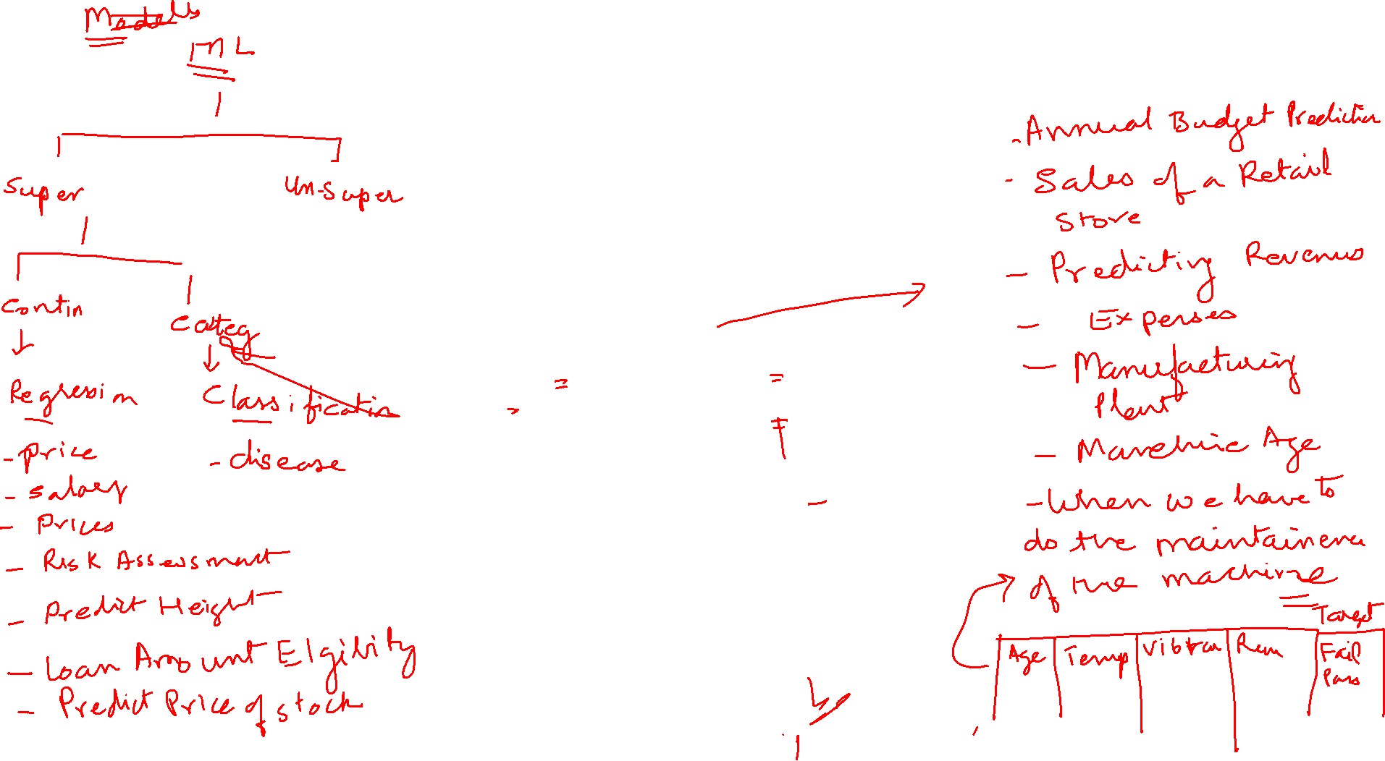

Slide 5
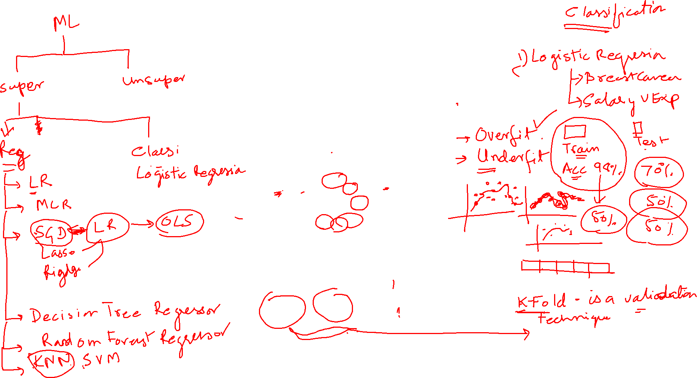

Slide 6
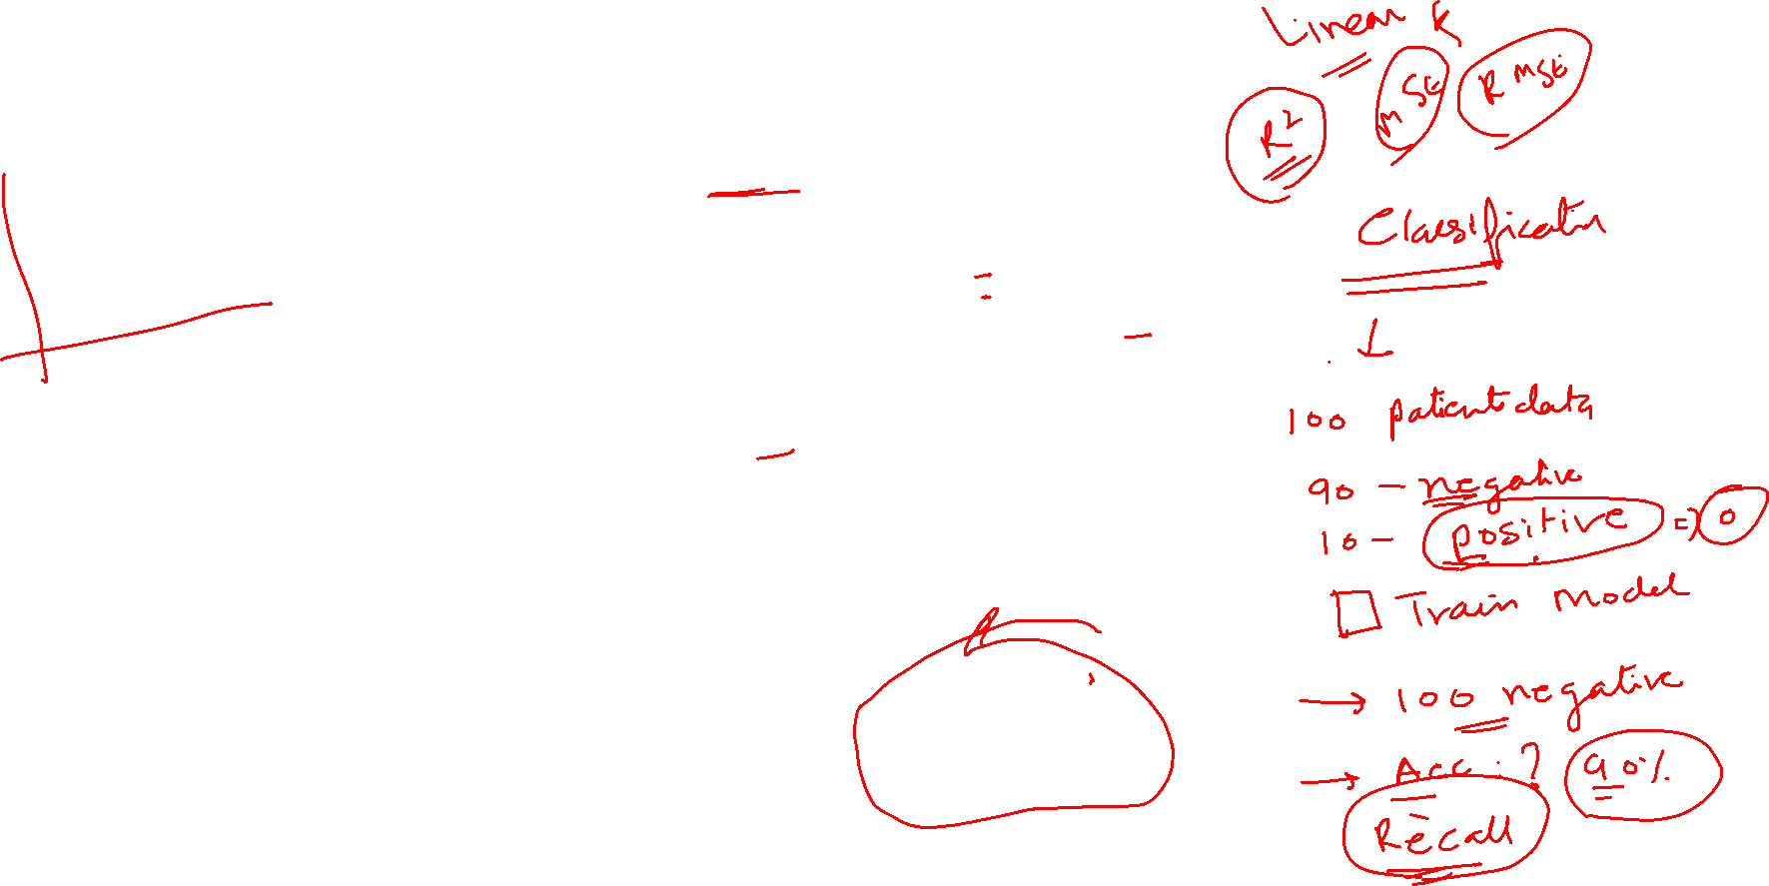

Slide 9








Predictive Analytics Approach
Understand Data
Identify the data that is relevant to business goals
Data Lake Set-up
Data Preparation and Cleansing
Processing and Preparation for Analytics tools like R
Analytics, Data Visualization
Analytics using Tools like R, Spark.
Log Analytics using ELK, Splunk Tools, Hadoop ecosystem tools like spark.
Data Visualization : D3js, Tableau
Hadoop Administration and Operation Support
Monitor
Measure the effectiveness of the model in real world
Prepare Data
Integrate & Enrich data into an analytical data set
PREDICTIVE ANALYTICS
Deploy
Use the model in applications
Model
Run statistical & machine learning algorithms to find the model
Evaluate
Test the model to make sure it will work

Slide 10
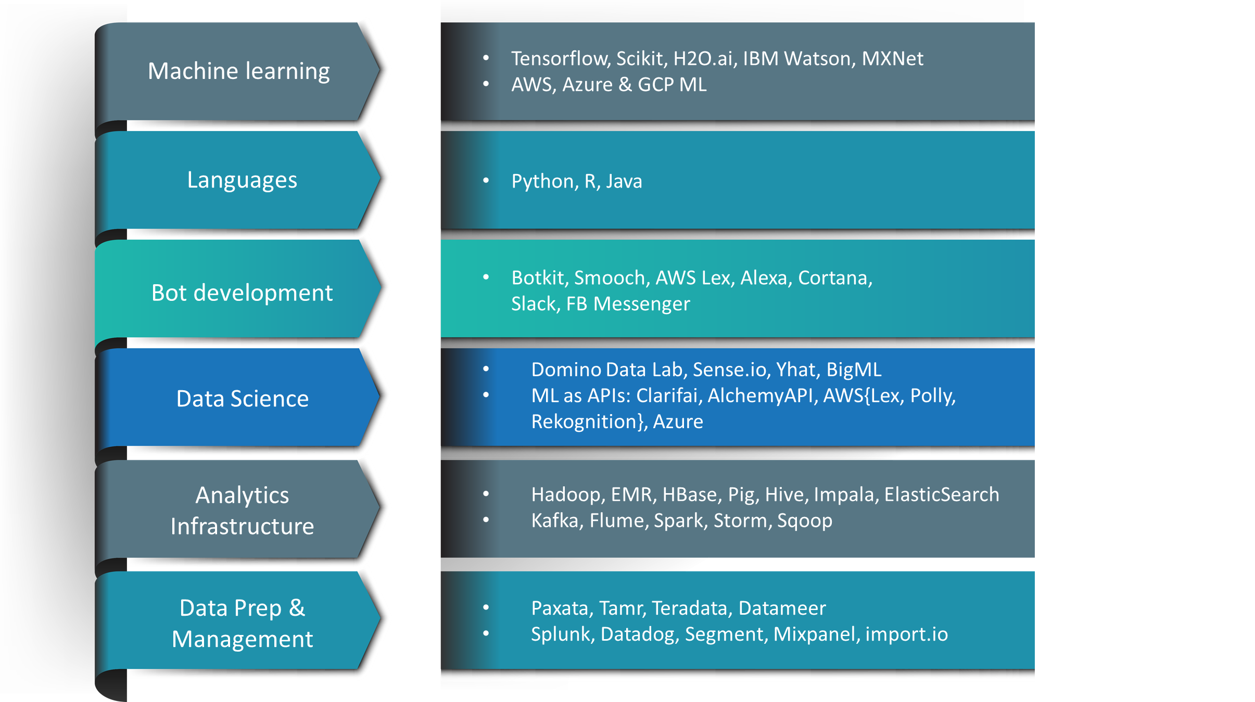
AI and Machine Learning Solutions we offer
We build intelligent applications and components using machine learning libraries and ML cloud services.
Product engineering & QA services to AI & ML-based product ISVs
QA for ML | Manual and automated QA for machine learning algorithms & implementations.
Data Pipelining & Preparation | Aggregate data from various sources & create robust pipelines. Collect, aggregate, clean & prep data Data lifecycle management
DevOps for ML | CI/CD for your ML & data infrastructure. Deploy and manage all ML & big data components Manage your ML cloud services
ML Solutions | Leverage ML libraries & ML cloud services to build solutions for B2B and B2C software. Bots, NLP, predictive analytics, image recognition etc.

